Slide 1

PGA Tour data analysis
Jonathan Nocek – Illinois Wesleyan university
Notes:
Title Slide
About Me
Data Frame
Scraping and Cleaning
Explanation of Columns
Questions

Slide 2


ABOUT ME
Computer Science Major
Data Science Minor
Men’s Golf Team
2019 DIII National Champions

Slide 3




WHAT Separates PGA TOUR Golfers?

Slide 4

IS THIS TRUE?

Slide 5
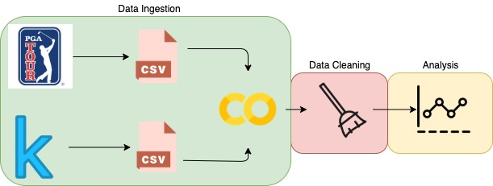

Slide 6
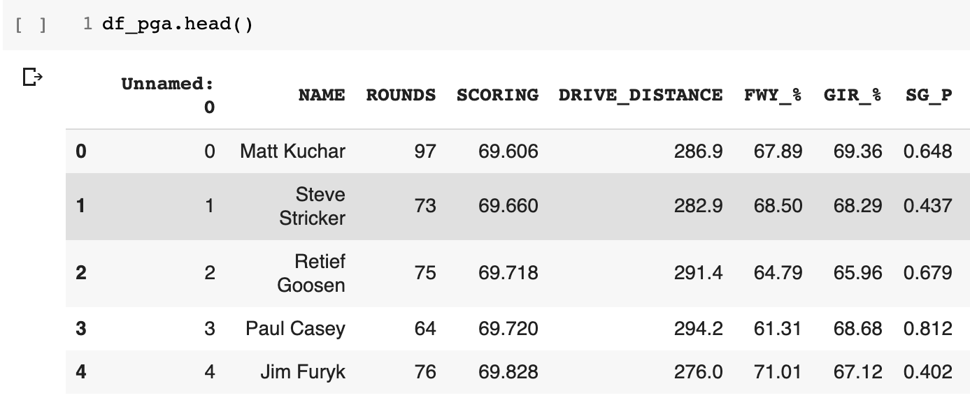

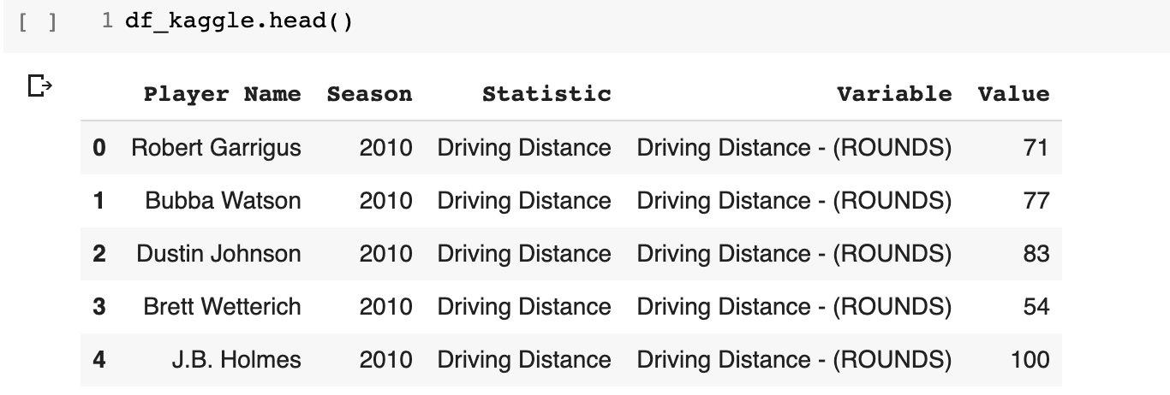


Slide 7
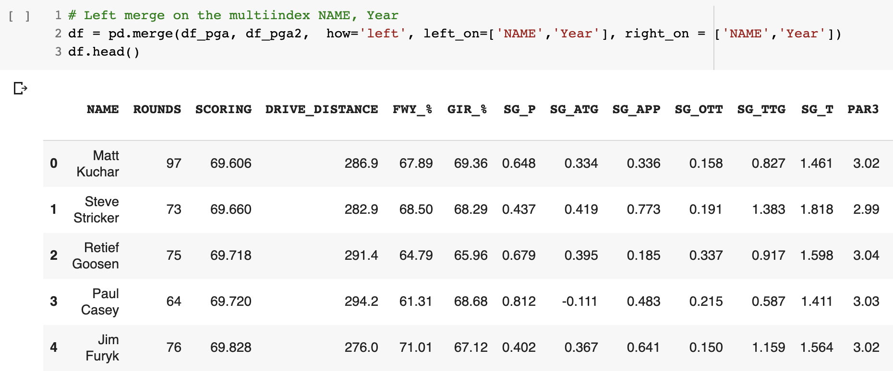
1866 rows x 33 columns

Slide 8
WHAT Separates PGA TOUR Golfers?
SCORING - The average number of strokes taken by a player during a single round.
FWY_% (FAIRWAYS) -The percentage of time a tee shot comes to rest in the fairway
GIR_% (GREENS IN REGULATION) -The percent of time a player was able to hit the green in regulation.
SG (STROKES GAINED) – Player performance versus the field measured in the strokes
DRIVING DISTANCE – The average number of yards measured per drive.

Slide 9
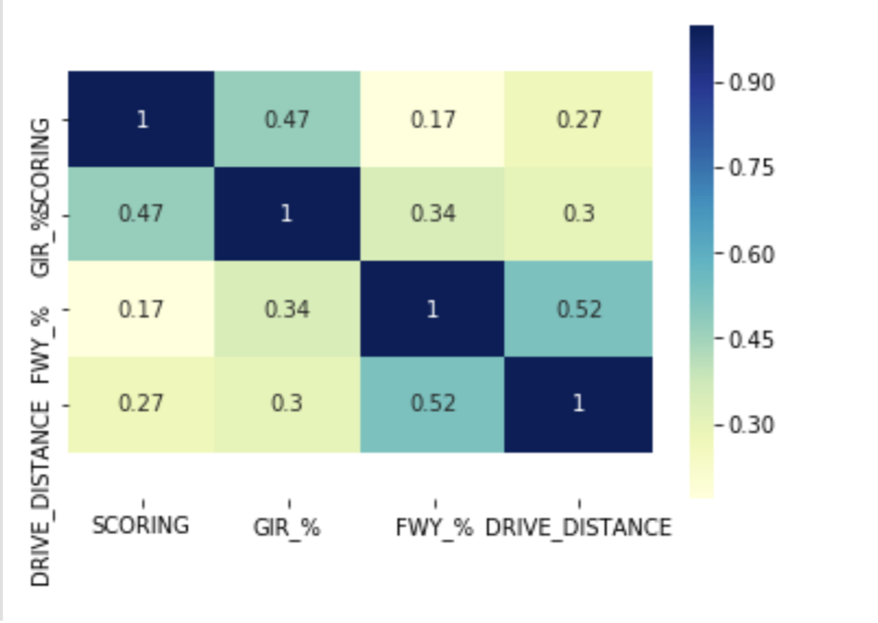
Observation: Greens and Distance are more important to scoring than fairways (accuracy)

Slide 10
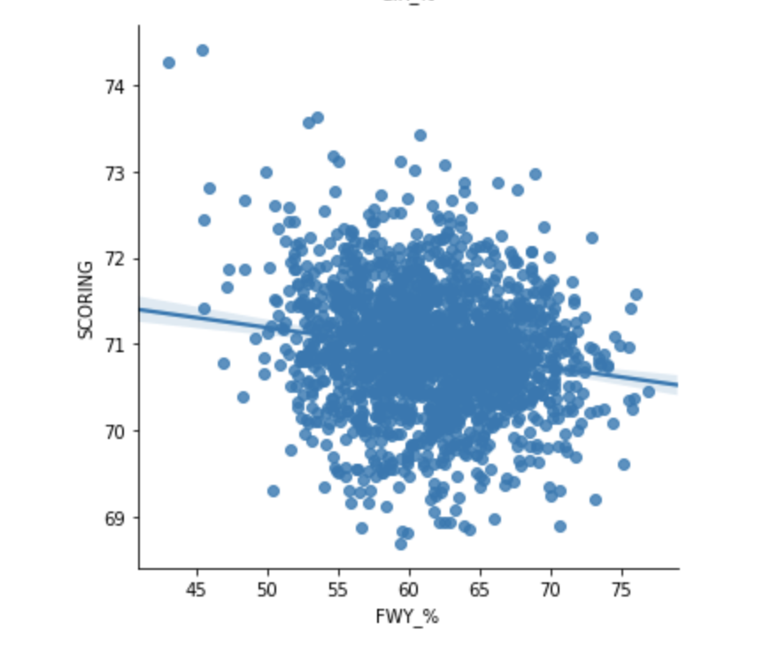
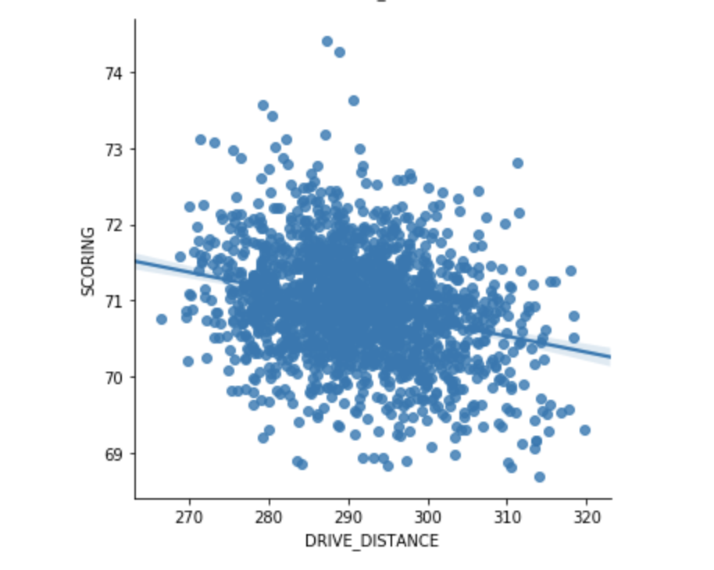
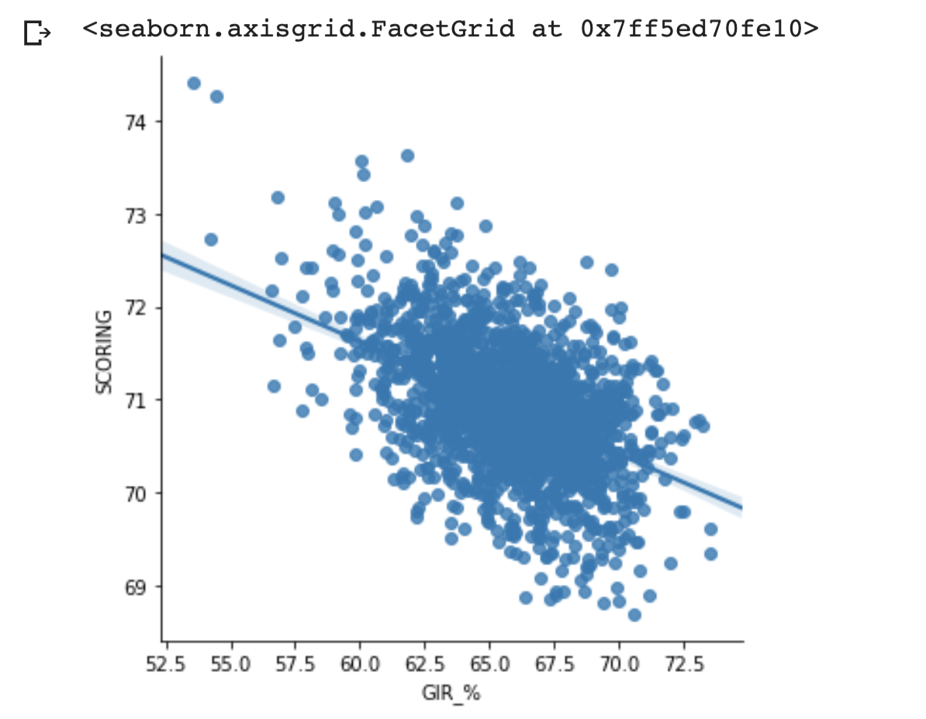
Fairway vs. Scoring
Distance vs. Scoring
Greens vs. Scoring
Observation: Greens and Distance are more important to scoring than fairways (accuracy)

Slide 11
Putting (P)
Around the Green (ATG)
Approach (APP)
Off the Tee (OTT)
Observation: Greens and Distance are more important to scoring than fairways (accuracy)

Slide 12
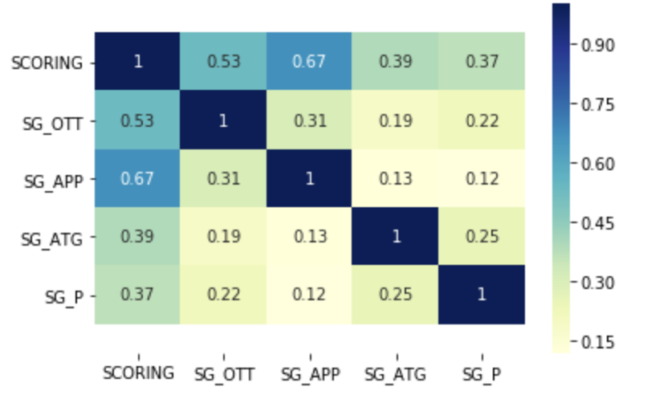
Observation: Putting is not very important (Drive for show and putt for dough?)

Slide 13
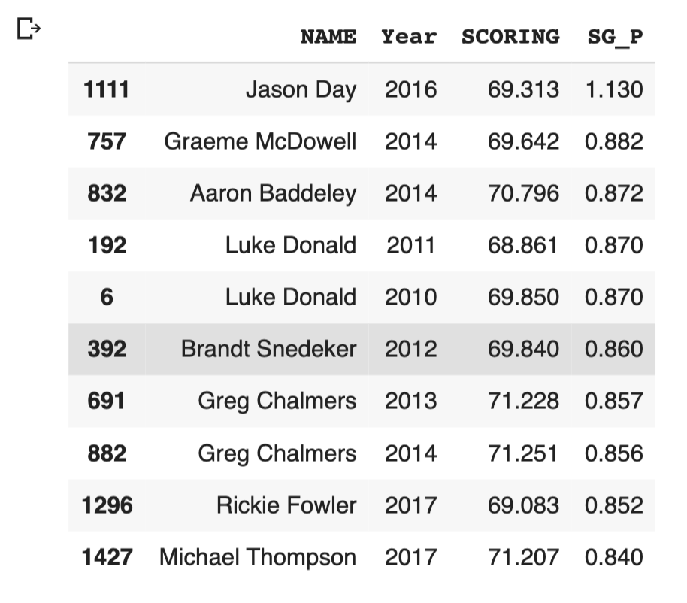
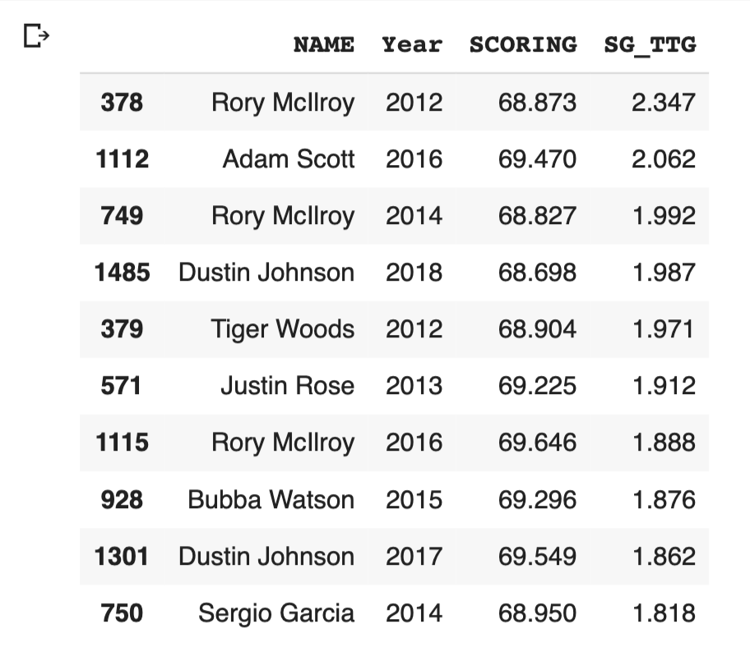
Observation: Good ball striking will lead to good scoring. Good putting might not.

Slide 14
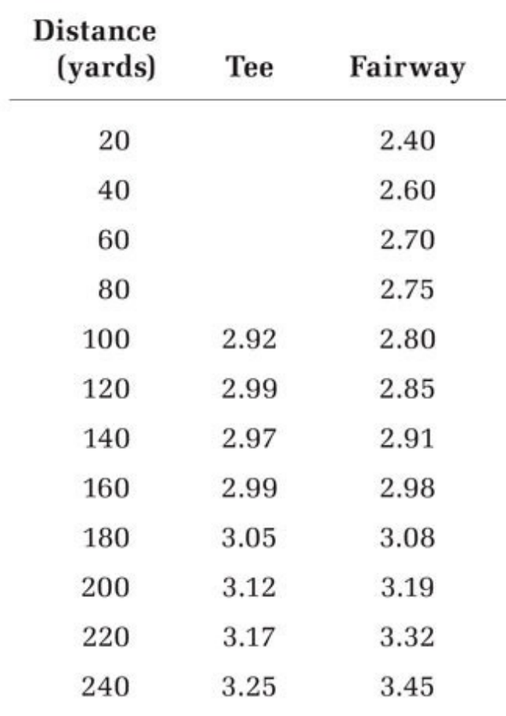
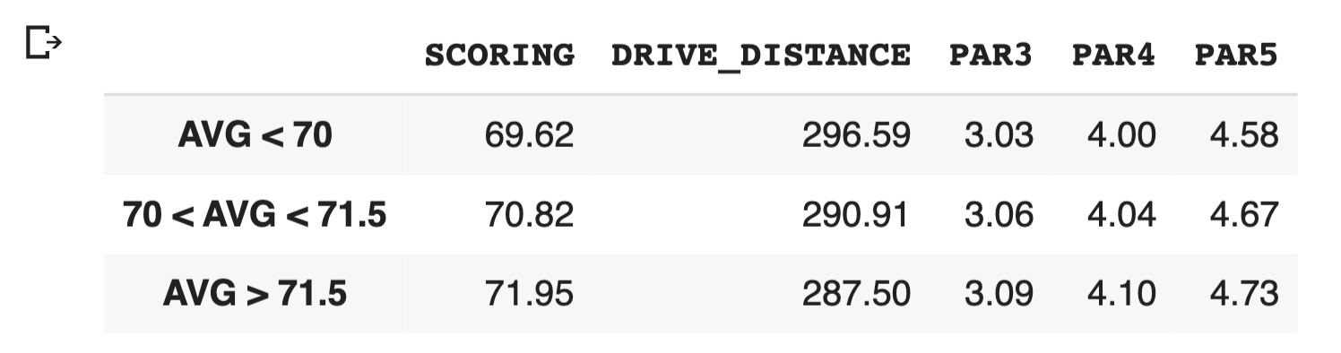
Observation: Good players hit it farther. Distance can add up over a round.

Slide 15
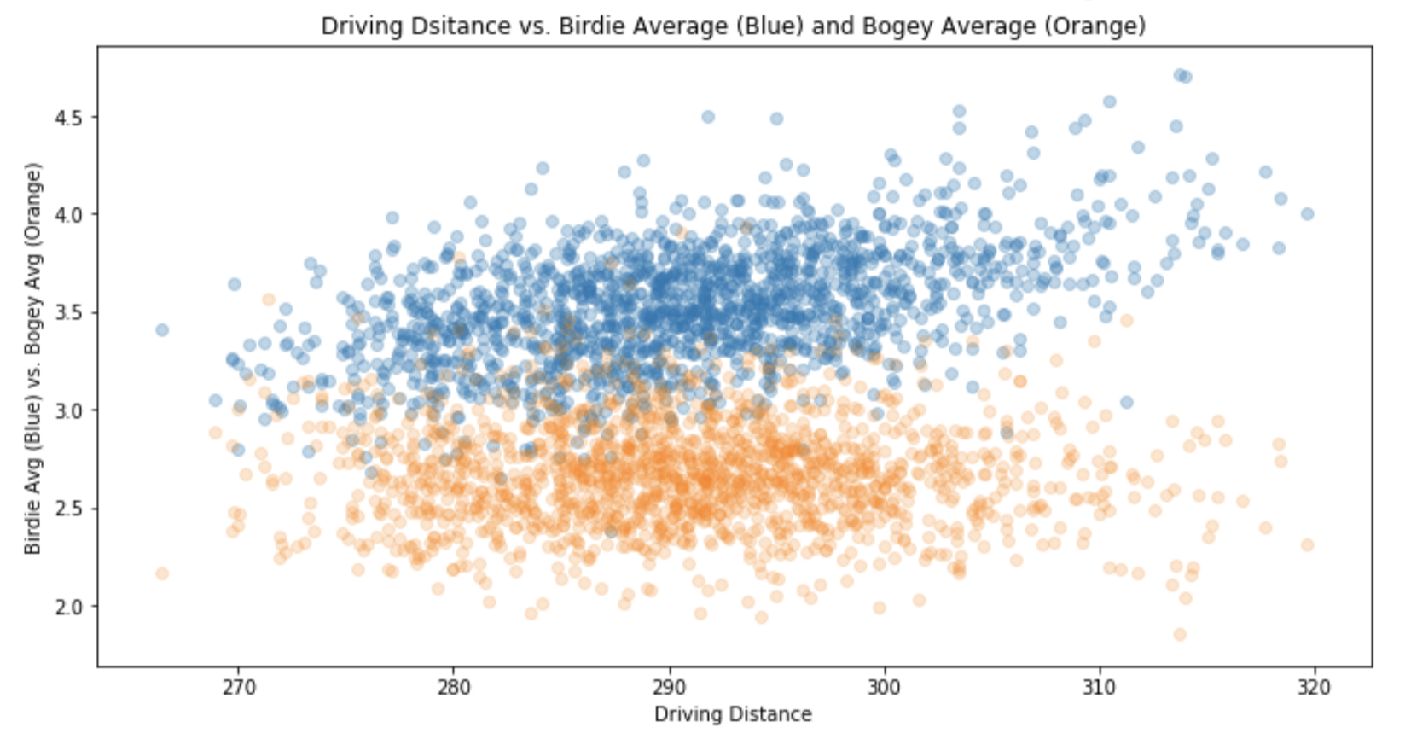
Observation: As driving distance goes up, Birdie average goes up and Bogey average goes down

Slide 16
Observations
What separates PGA TOUR Golfers?
”Drive for show, putt for dough” is not true.
”Bomb and Gouge” is the current state of the TOUR
Hitting it far > being accurate
Hitting it far > putting
Driving and Irons are the keys to consistent golf

Slide 17
Potential future analysis

Slide 18
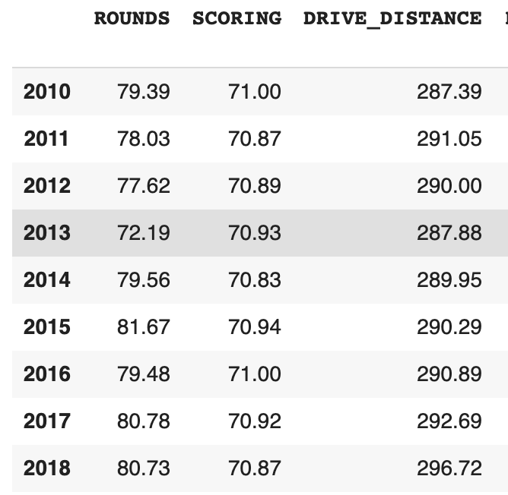
FUTURE ANALYSIS
Why has driving distance increased?
Better athletes?
Better technology?
In the future
Is there a maximum driving distance that we are approaching?

